Slide 1
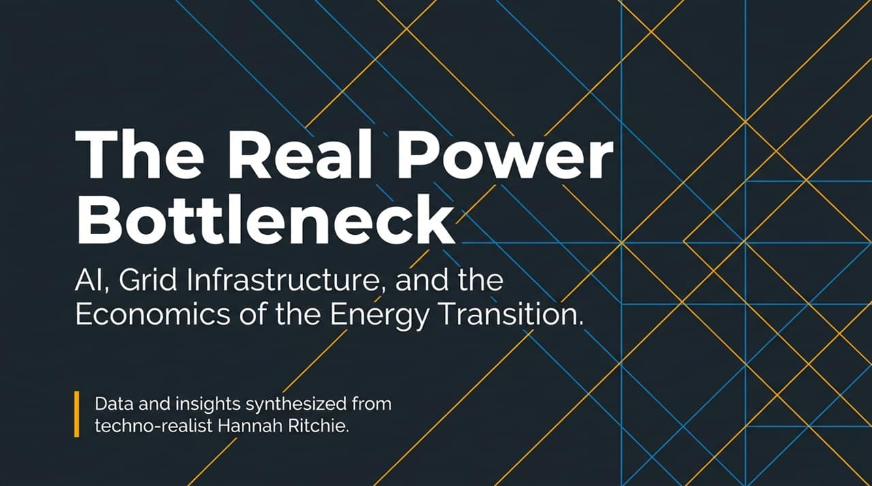
Notes:
Opening: Welcome everyone. Today, we’re unpacking one of the most critical, yet frequently misunderstood, challenges facing technology, energy, and global economics: the real bottleneck in the energy transition.
Core Theme: While media headlines focus heavily on AI taking over global energy supplies or runaway climate threats, the actual numbers tell a far more nuanced, techno-realist story.
Source Context: These insights synthesize global data curated by Hannah Ritchie, Senior Researcher at Oxford University and Deputy Editor at Our World in Data.
Key Takeaway to Set Up: The central takeaway today is that the energy transition isn’t limited by a lack of renewable potential or even global power volumes. It is fundamentally an infrastructure execution and regulatory velocity problem.
https://youtube.com/watch?v=GkAtcFOudDE

Slide 2
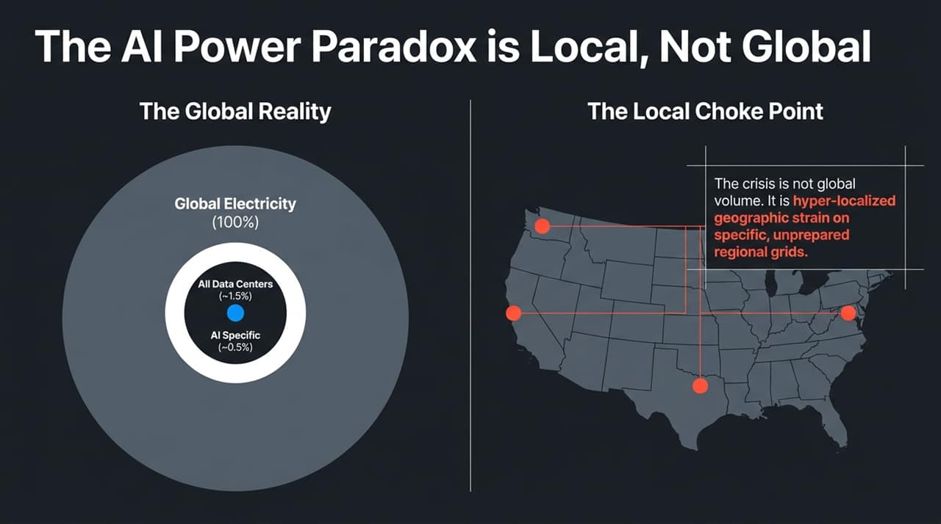
Notes:
Addressing the Narrative: There is a pervasive narrative that AI’s massive energy consumption is driving a global power crisis. Let's examine the macro accounting from the International Energy Agency (IEA).
Data Breakdown:
All data centers globally—combining everything digital from streaming podcasts to cloud enterprise databases—consume roughly 1.5% of total global electricity.
AI-specific workloads account for approximately 0.5% of total global electricity.
The Local Bottleneck: If AI is only half a percent globally, why are utilities and tech executives sounding alarms? Because AI demand is hyper-localized.
Geographic Strain: Compute infrastructure isn't evenly distributed; it gets clustered in specific regional nodes—like Northern Virginia, Texas, or Dublin. These local grids, designed for steady 20th-century load profiles, are suddenly tasked with powering gigawatt-scale data clusters overnight. The crisis is localized grid unpreparedness, not total world capacity.

Slide 3
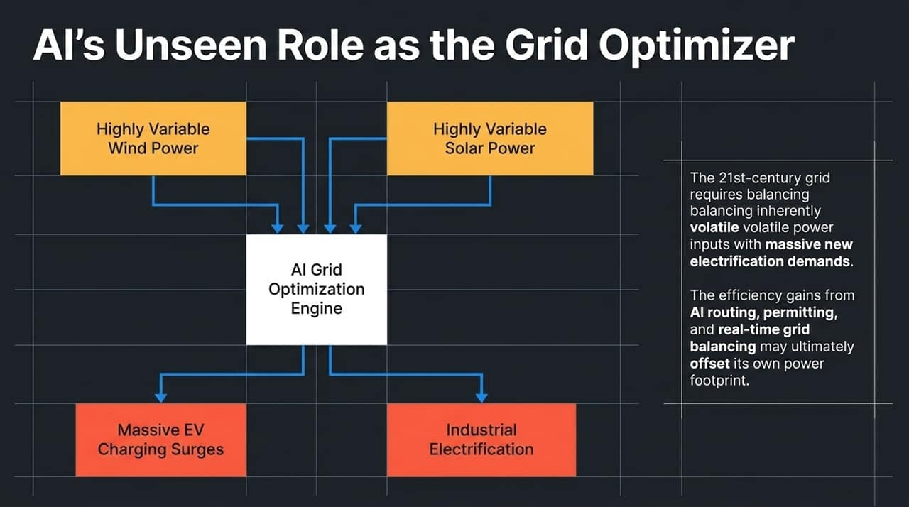
Notes:
The Dual Nature of AI: While AI adds load, it also serves as a key tool for solving grid management.
Grid Volatility: The modern grid is growing vastly more complex. We are adding volatile, variable power inputs (solar and wind) while simultaneously overlaying massive new demand spikes from EV fast-charging and industrial electrification.
AI as the Balancer: AI orchestration engines are capable of real-time load matching, dynamic routing, predictive weather-to-generation forecasting, and accelerating permitting processes.
Net Impact: As AI models assist in material discovery for better batteries and optimize transmission flow, the efficiency gains derived from AI could net-offset a substantial portion of its own power footprint over the coming decade.

Slide 4
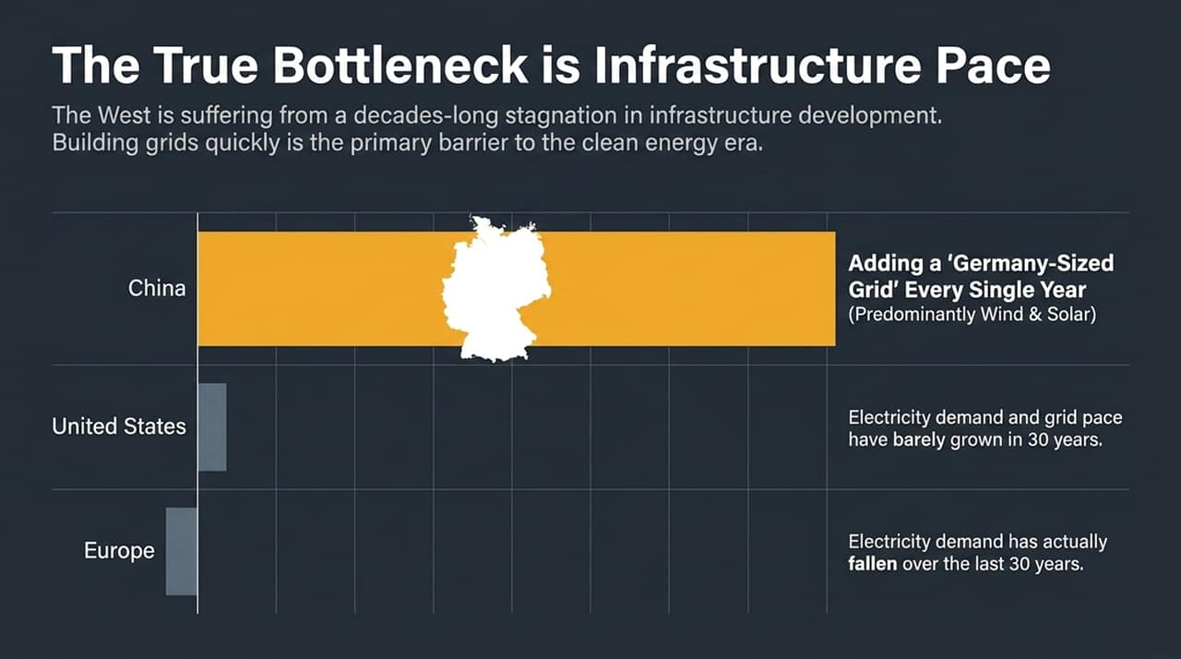
Notes:
Divergence in Building Speed: Look at the stark divergence in grid construction velocity between Western economies and China.
Western Stagnation: The US and Europe have experienced flat or declining electricity demand growth for nearly 30 years. As a result, regulatory frameworks, permitting processes, and supply chains lost the muscle memory required to build heavy transmission lines quickly.
The China Scale: In contrast, China adds the equivalent of Germany’s entire electric grid every single year—and the vast majority of that net expansion comes from wind and solar power.
The Core Lesson: Western AI expansion and clean energy deployment aren't restricted by capital or clean tech options, but by how fast lines can be permitted and laid in the ground.

Slide 5
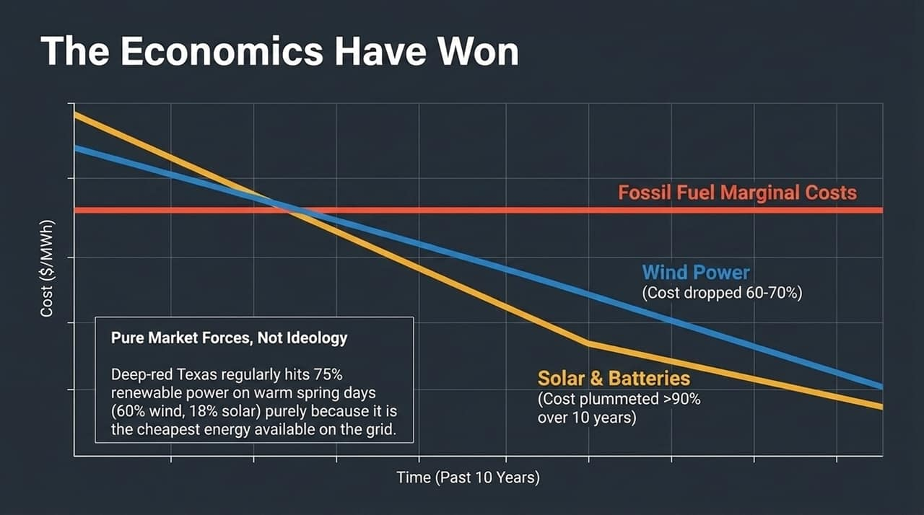
Notes:
Historical Cost Shift: A decade ago, choosing clean energy required paying a green premium. Today, pure market forces drive the transition.
Plummeting Costs: Over the past decade, solar module and battery storage costs dropped by over 90%, while wind power costs plummeted by 60% to 70%.
Case Study (Texas): On sunny, windy days, "deep-red" Texas regularly generates around 75% of its total power from renewables (roughly 60% wind, 18% solar). This isn't driven by climate mandates; it's because renewables represent the cheapest marginal cost energy on the market.
Takeaway: Energy deployment is no longer an ideological battle; it is an economic selection mechanism.

Slide 6
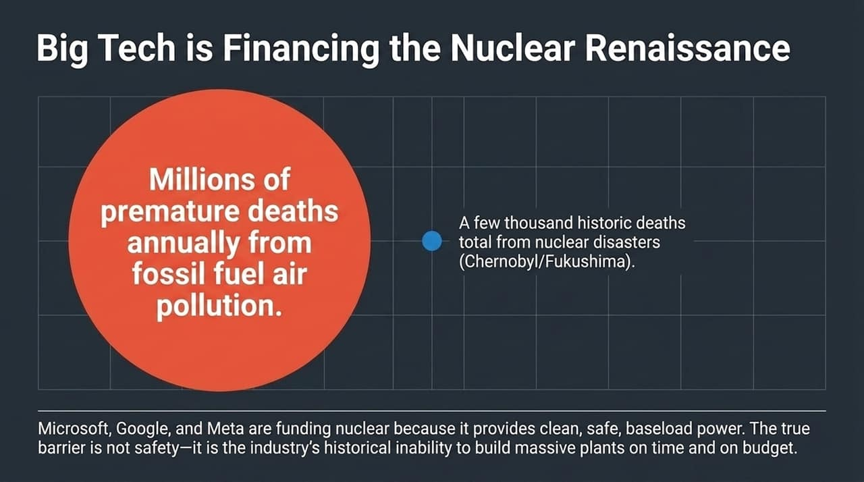
Notes:
Baseload Demand: Big Tech hyperscalers (Microsoft, Google, Amazon, Meta) require 24/7 continuous clean baseload power that intermittent renewables alone struggle to provide without massive long-duration storage.
Safety vs. Perception: Public fear surrounding nuclear focuses on rare, catastrophic events like Chernobyl or Fukushima, which historically account for a few thousand total deaths. Meanwhile, fossil fuel air pollution causes millions of premature deaths annually.
The Real Obstacle: Nuclear power’s actual challenge is financial and managerial: historically, Western nuclear projects have suffered from massive budget overruns and construction delays. Hyperscaler balance sheets are stepping in to de-risk and fund Small Modular Reactors (SMRs) and plant re-starts.

Slide 7
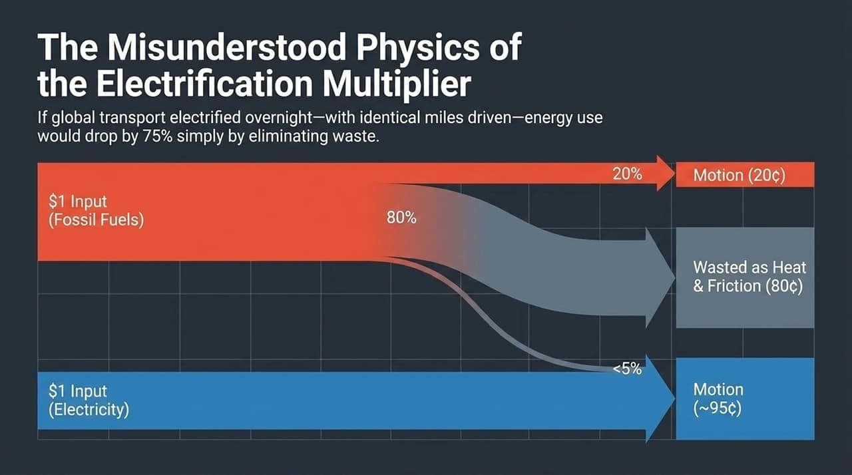
Notes:
Thermodynamic Efficiency: A primary benefit of shifting from fossil fuels to electricity is dramatic efficiency gains.
Combustion Waste: Internal combustion engines (ICE) are fundamentally heat engines that produce motion as a byproduct. When you spend $1 on gasoline, 80 cents is lost as wasted heat and friction, leaving only 20 cents for actual propulsion.
Electric Efficiency: Electric vehicles flip this ratio. Around 95% of electrical energy translates directly into vehicle motion.
Systemic Impact: If global transport electrified overnight, overall primary energy consumption for transport would drop by up to 75% without reducing total miles traveled.

Slide 8
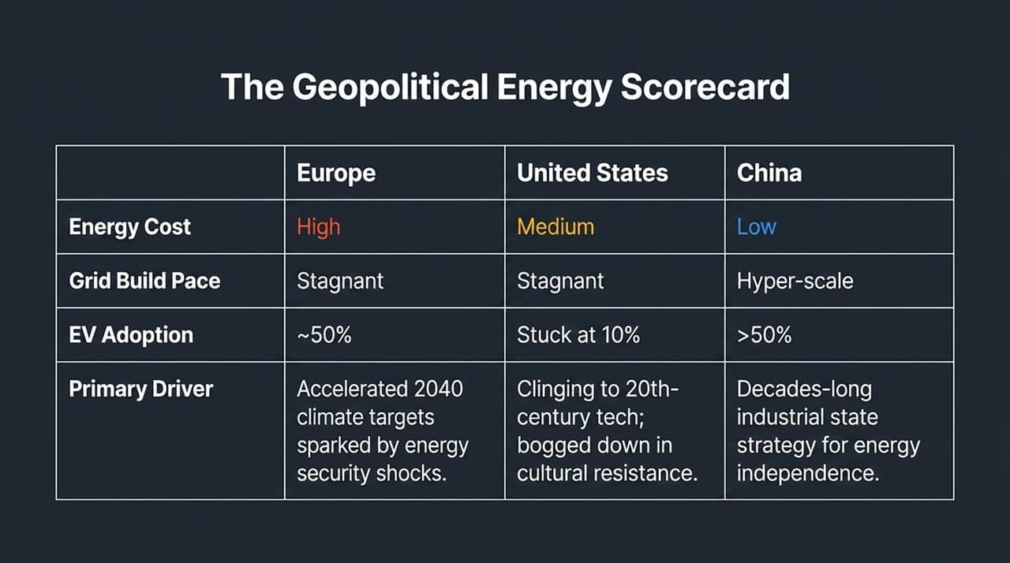
Notes:
Regional Comparison: Comparing the strategy and status across Europe, the US, and China:
Europe: High energy costs, stagnant grid growth, but high EV adoption (~50%) spurred by energy security shocks following the Russia/Ukraine war.
United States: Medium energy costs, flat grid build pace, and lagging EV adoption (~10%) due to cultural resistance, large-vehicle preference, and regulatory fragmentation.
China: Low energy costs, hyper-scale grid deployment, and >50% EV adoption driven by a long-term state strategy for industrial dominance and energy self-reliance.

Slide 9
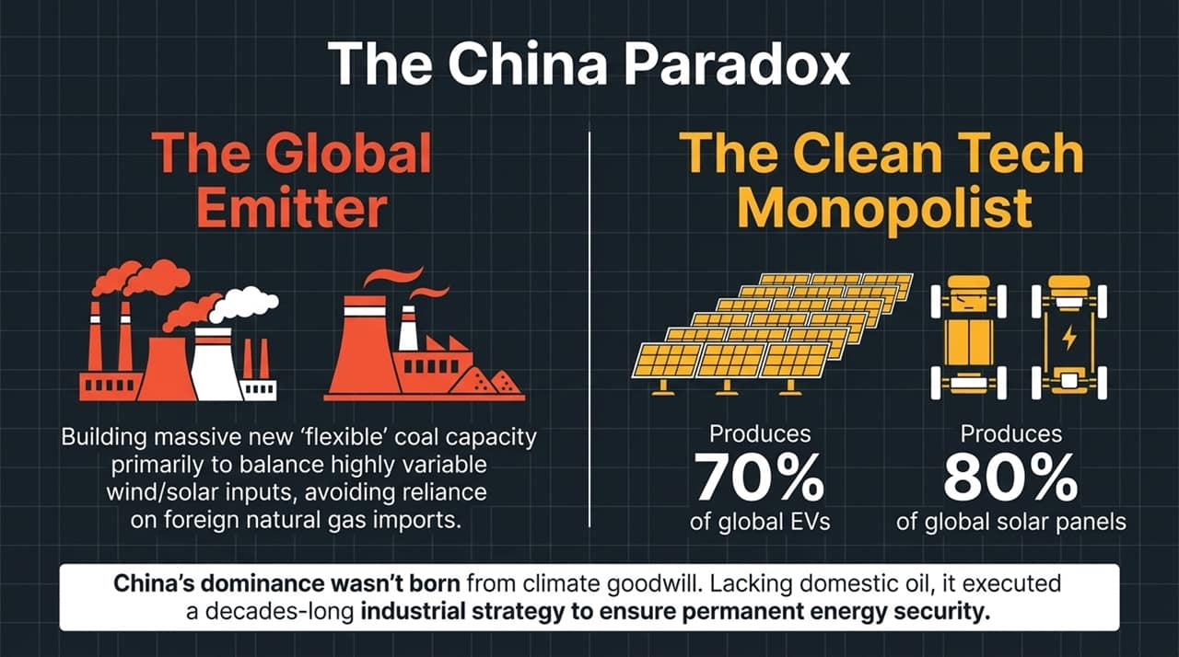
Notes:
Dual Reality: China presents a fascinating duality—it is both the world's largest coal burner and the dominant clean tech manufacturer.
Supply Chain Dominance: China controls over 80% of global solar panel manufacturing and produces 70% of global EVs.
Coal as Grid Backup: China continues to build coal plants not necessarily to run them continuously, but to provide flexible peak capacity and grid backup for massive solar and wind inputs, bypassing the need for imported natural gas.
Strategic Intent: China’s transition was planned decades ago as a pure national security play to eliminate dependence on foreign oil imports.

Slide 10
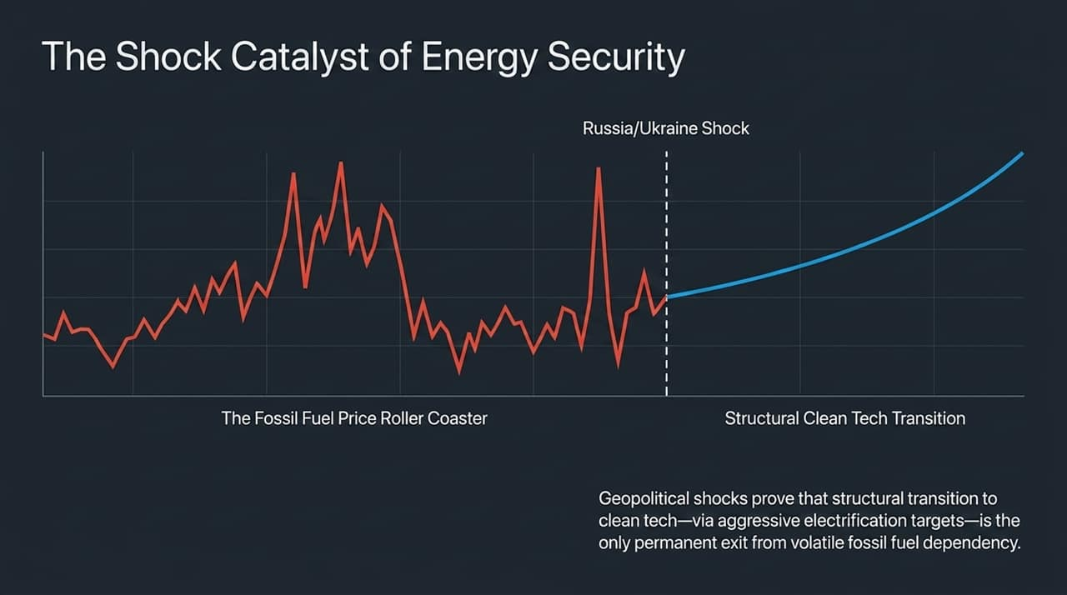
Notes:
Volatilities of Fossil Fuels: Geopolitical shocks—like the Russia/Ukraine invasion and Middle East conflicts—demonstrate that fossil fuel dependency creates constant economic vulnerability.
Structural Shift: Volatility drives countries toward structural energy independence through accelerated domestic electrification.
The Strategic Choice: Nations are choosing between endless price volatility on fossil fuels or upfront capital deployment into domestic clean energy assets that lock in predictable, lower-cost energy for decades.

Slide 11
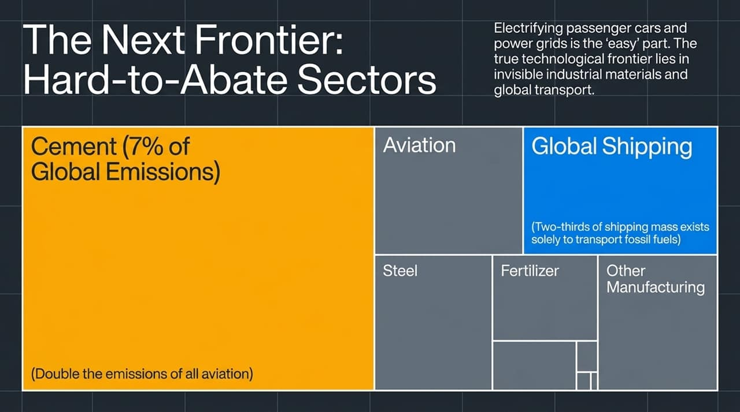
Notes:
Beyond the Easy Wins: Electrifying passenger cars and building solar farms are the relatively straightforward parts of the energy transition.
Industrial Heavyweights: The major decarbonization challenges lie in heavy materials and freight transport:
Cement: Responsible for ~7% of all global greenhouse emissions.
Steel: Emits double the global emissions of the entire commercial aviation sector.
Global Shipping: Notably, roughly half to two-thirds of global maritime shipping mass exists solely to transport fossil fuels around the globe. Shifting away from fossil fuels simultaneously reduces maritime transport demand.

Slide 12
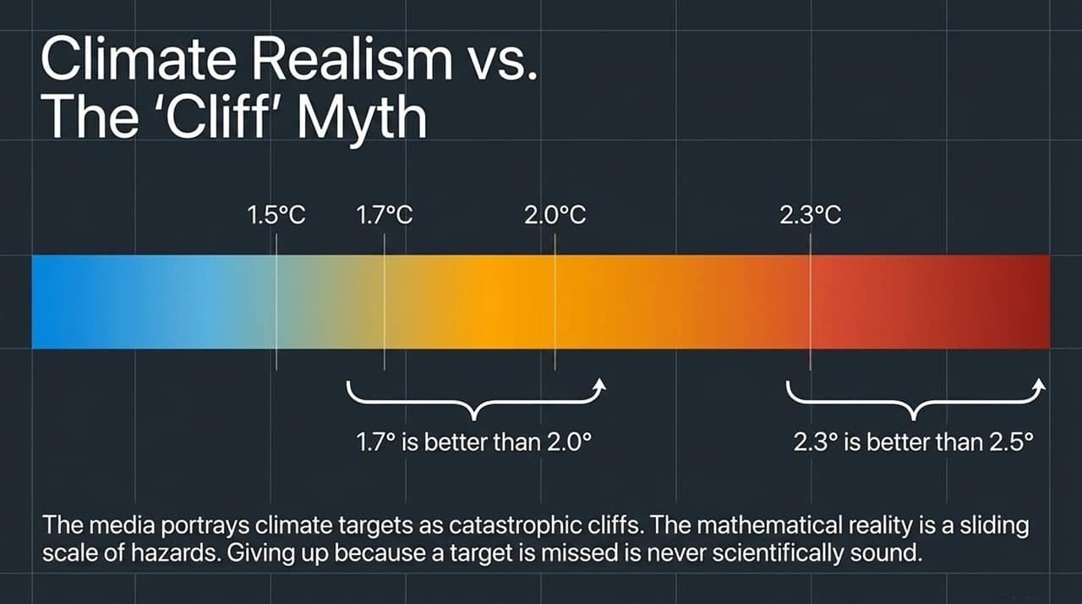
Notes:
Reframing Climate Targets: Media discourse frequently frames climate thresholds (like 1.5°C or 2.0°C) as catastrophic, apocalyptic cliffs.
Gradual Hazards: Scientific reality shows a continuum of risk. Missing 1.5°C does not mean total failure; 1.7°C is safer than 2.0°C, and 2.3°C is better than 2.5°C.
Actionable Perspective: Giving up because an arbitrary policy target is breached is scientifically unsound. Every tenth of a degree avoided measurably reduces global hazards.

Slide 13
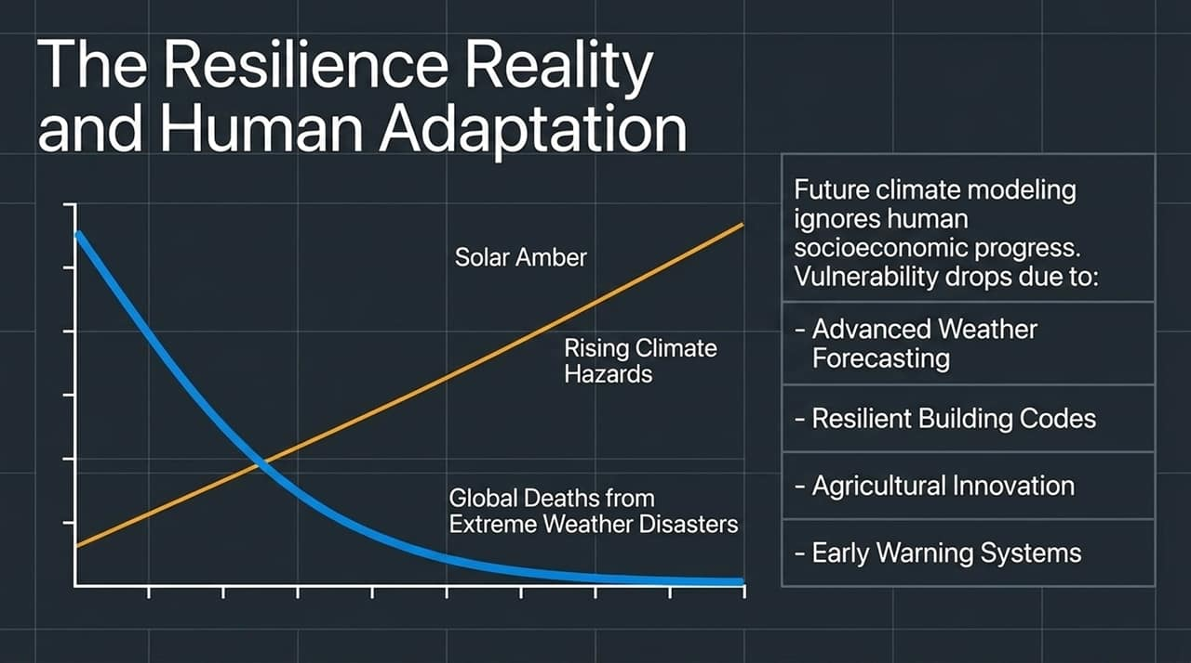
Notes:
Accounting for Human Adaptation: Predictive climate models often assume a static world where human adaptation remains frozen in time.
Declining Mortality: Over the last century, despite rising climate hazards and population growth, global deaths from extreme weather disasters have declined drastically.
Drivers of Resilience: Advanced satellite weather forecasting, early warning systems, modern resilient building codes, and agricultural innovation actively reduce vulnerability even as weather hazards increase.

Slide 14
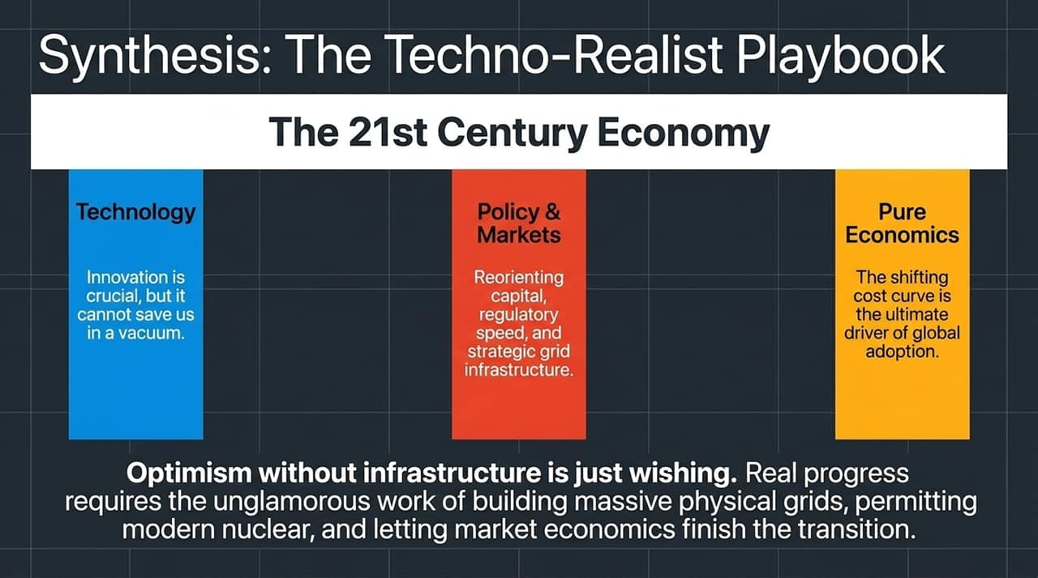
Notes:
Triad of Progress: Real progress requires aligning three distinct pillars:
Technology: Vital for discovery, but incapable of solving problems in isolation.
Policy & Markets: Unlocking capital, streamlining regulatory review, and speeding up grid construction.
Pure Economics: The underlying driver that leads to global scale adoption.
Closing Thesis: "Optimism without infrastructure is just wishing". Achieving a low-carbon, high-compute future requires the unglamorous physical work of expanding transmission grids, permitting modern nuclear power, and enabling market economics to drive execution.

Slide 15
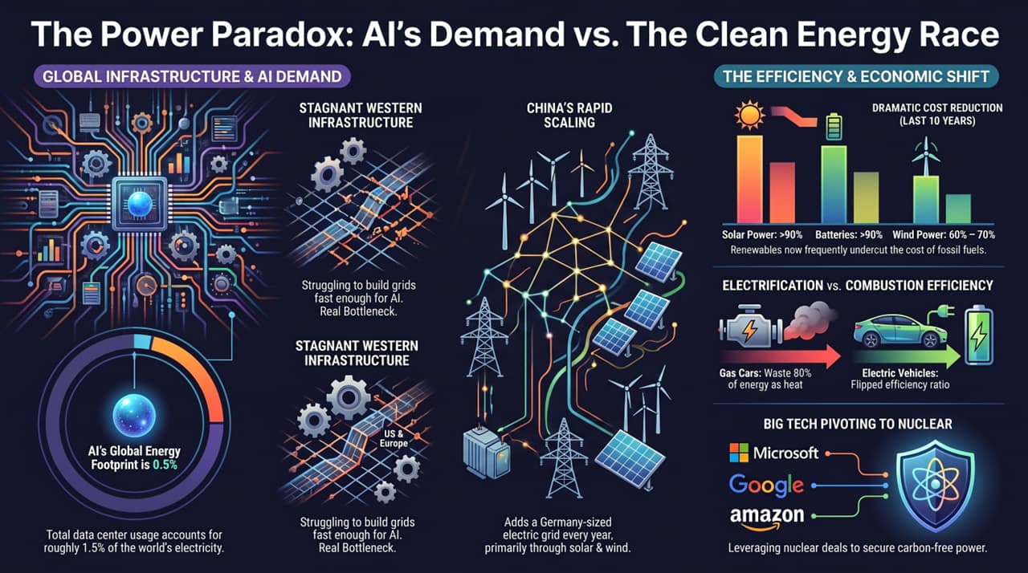
Notes:
Executive Overview: This summary slide connects the key themes of the presentation deck:
1. AI vs Grid Capacity: AI isn't straining global capacity (0.5% global load), but concentrated local bottlenecks present real risks.
2. The Western Grid Gap: While China deploys grid capacity rapidly, the US and Europe remain constrained by legacy permitting processes.
3. Economic Mechanics: Renewables and battery costs have dropped >90% over 10 years, making clean power the default economic choice.
4. Tech Strategy: Big Tech's shift toward direct nuclear power agreements provides stable, zero-carbon baseload power for future AI scale.

